Slide 1
LENIDNG CLUB CASE STUDY SUBMITTED BY:-
Name: Koustav Chakraborty
Amay Trivedi

Slide 2
Business Understanding
Company:
Lending Club is the largest online loan marketplace, facilitating personal loans, business loans, and financing of medical procedures.
Borrowers can easily access lower interest rate loans through a fast online interface.
Context:
Lending Club wants to understand the driving factors behind loan default,
i.e. the driver variables
which are strong indicators of default.
The company can utilize this knowledge for its portfolio and risk assessment.
Problem Statement:
As a data scientist working for Lending Club we need to analyze the dataset containing information about past loan applicants using EDA along with the loan status whether they defaulted or not. Also we need to identify the pattern if a person is likely to default.

Slide 3
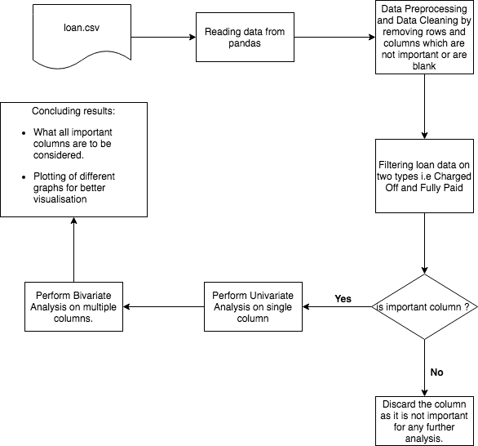
Flow Chart

Slide 4
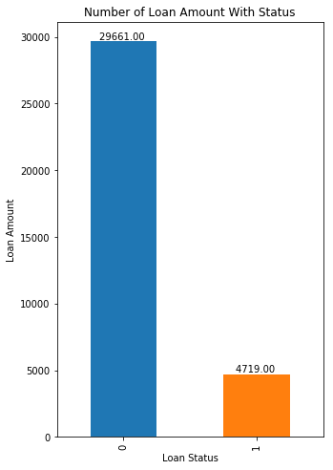
Univariate Analysis- Loan status
It can be seen from the above bar plots that we have around 30,000 Fully Paid and around 4500 as Charged Off or Defaulters
Approximately 14% of the loans are defaulted.
Any variable that increases percentage of default to higher than 16.5% should be considered a business risk.
Total loan

Slide 5
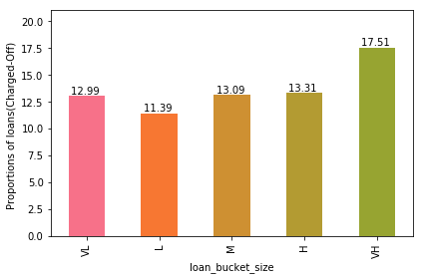
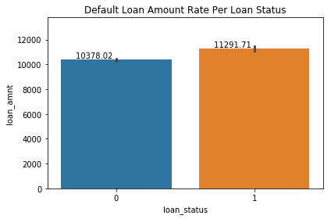
Univariate Analysis- Understanding of Loans continued
Percentage of loans charged off
Default Loan Amount per Loan Status
The percentage of Charged off increases as the loan amount gets higher and higher. Frequency of loans are in range less than 20k
The percentage of Charged off increases as the loan amount gets higher and higher. Frequency of loans are in range less than 20k

Slide 6
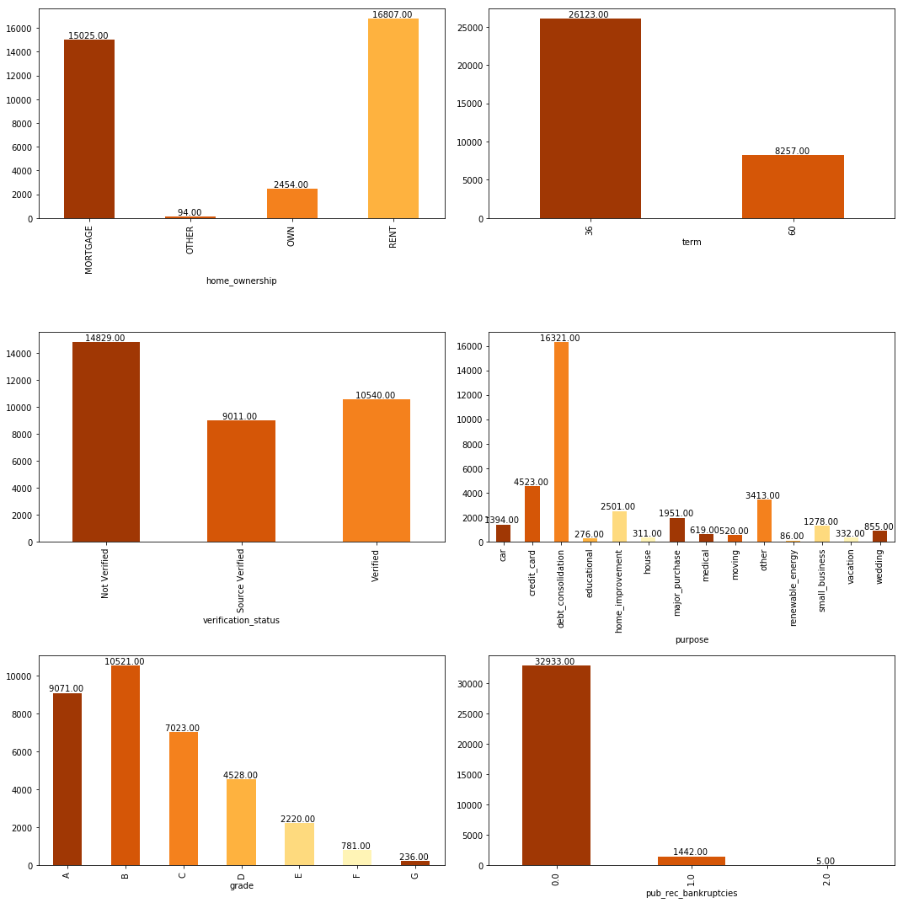
Univariate Analysis - Categorical variables
1)For home ownership, most of the people tends to take loan amount for RENT and Mortgage.
2)The term column i.e The number of payments on the loan. Values are in months and can be either 36 or 60 from Data dictionary. People tend to take 36 months loan more.
3)Not verified (Letter of Credit) people tends to get more loan amount. This is alarming as source is not verified which can possibly turn to defaulters.
4)For debt consolidation most of the people takes loan.
5)Most loans are high grade.

Slide 7
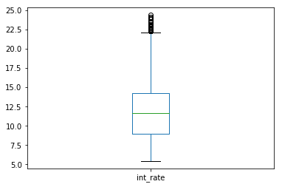
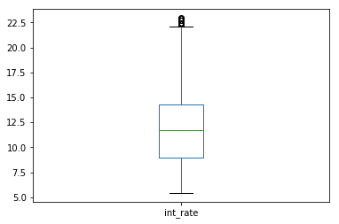
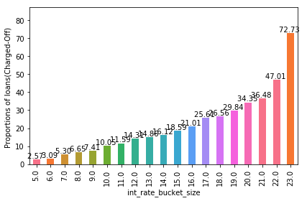
Analysis- Interest rate
Box plot for outlier detection
Box plot after removing outlier
Percentage of interest rate
The interest rate of Charged Off appears to be more as compared to the Fully Paid. This can be seen from differences in averages. 13.751 and 11.563 respectively.

Slide 8
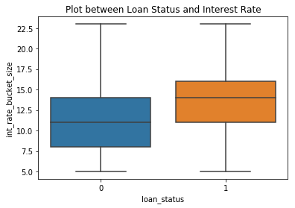
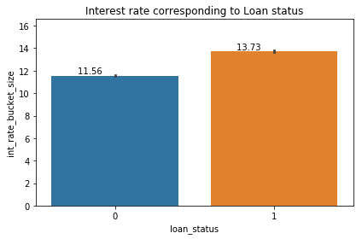
Bivariate Analysis – Loan Status and Interest rate
The interest rate for charged off is much higher than for the Fully Paid. Also, the 25 percentile differs a lot in this case. This can be due to following reasons:-
As the bank sees the risk, the interest varies abruptly for Charged Off.
For charged off customers the interest rate varies from 5% to 22%.

Slide 9
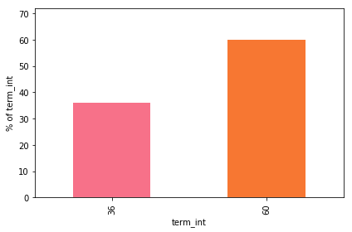
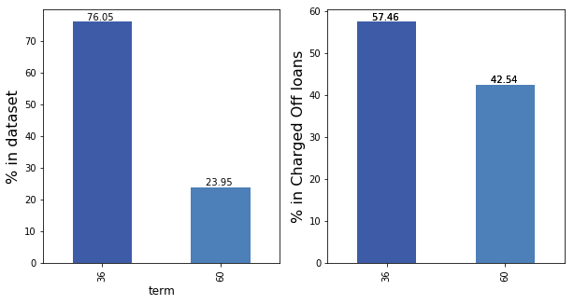
Bivariate analysis- term and interest rate
1)Overall 75% of the total loans are given for duration of 3 years, whereas 25% of the loans are those given for 5 years.
2)Among Charged Off loans, percentage of term 60 months rises to 43%.

Slide 10
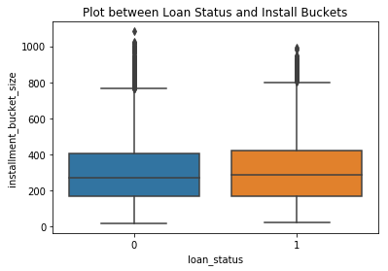
Bivariate analysis- Loan status and installment
Inferences:-
1)Loans with Charged Off have slightly higher number of installments.
2)The installment amount varies largely from 168 to 420.

Slide 11
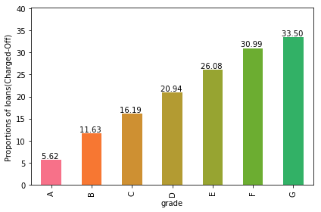
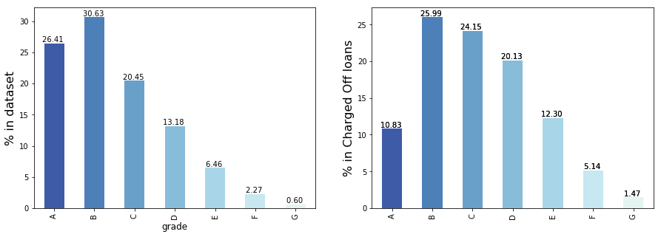
Bivariate analysis-Grade and Charged off loans.
Inferences:-
As grade is increasing the defaulters seem to increase, the maximum increase is for grade 'G' i.e. 33%.
Inferences:-
1)Grade A and B are safe loans as compared to E, F, G which are highly unsafe.
2)There is an increase in the overall dataset as compared with Charged off loans.

Slide 12
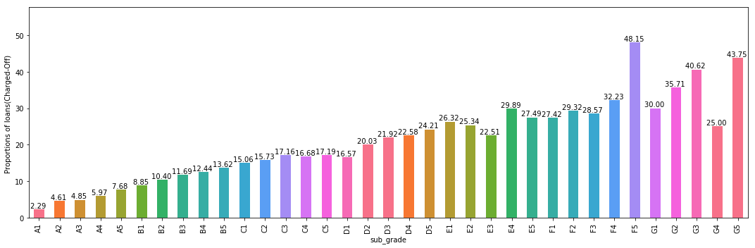
Bivariate analysis- Loan status and Subgrade

Slide 13
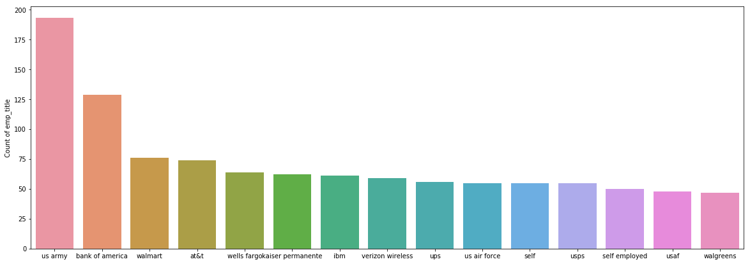
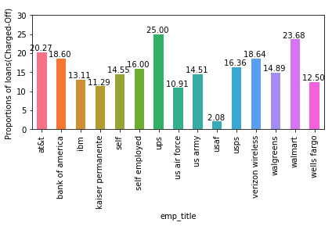
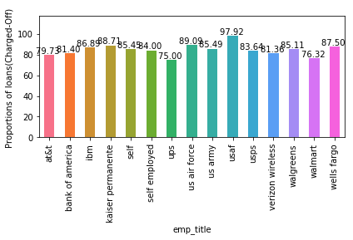
Bivariate Analysis- Emp_title vs charge off loan and Paid loan distribution
1)From the two plots on the left, it can be seen that USAF titled employees are paying their loan regularly as compared to any other sectors.
2)Ups titled employees are the highest who got Charged Off customers.
Most of the employees have title 'US ARMY' followed by 'Bank Of America'. Therefore, we can conclude that the employees with these top 15 employee titles tend to take more loans..

Slide 14
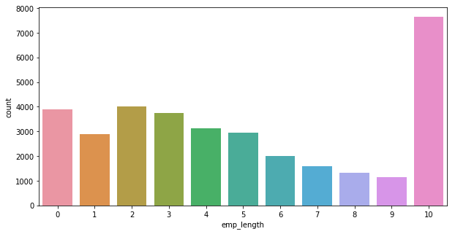
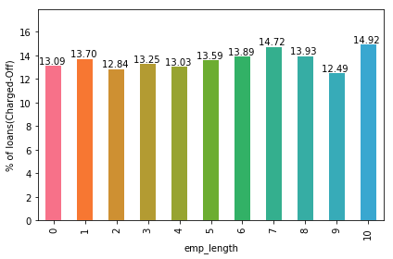
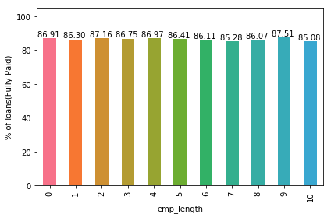
Bivariate Analysis- Emp_lengh vs charge off loan and Paid loan distribution
Inferences:-
1)Employees with more or within 10 years of experience tend to take more loans than any other people.
2)We can see that employee length of 10 years are more Charged Off.

Slide 15
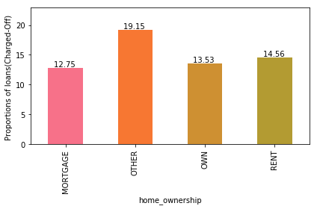
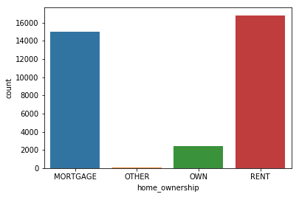
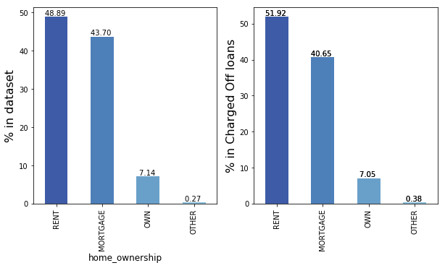
Bivariate Analysis- Home_Ownership vs charge off loan and Paid loan distribution
Most people tend to buy loans for 'RENT' as compared to any other categories whereas very few people take loans for 'OTHER'
The most Charged-Off loans are from 'OTHER' category in home ownership.

Slide 16
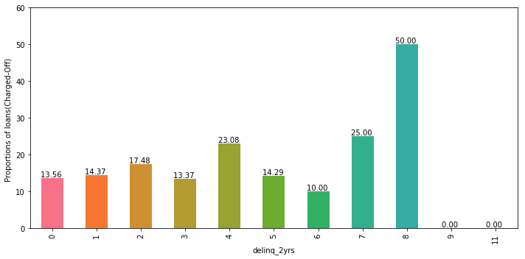
Bivariate Analysis- delinq_2yrs vs loan status
The number of 30+ days past-due incidences of delinquency in the borrower's credit file for the past 2 years values ranges between 0 and 11.
Most of the charged off loans are the ones with 8 years of delinquency..

Slide 17
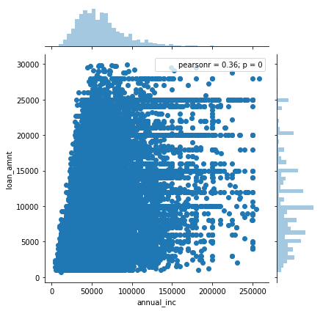
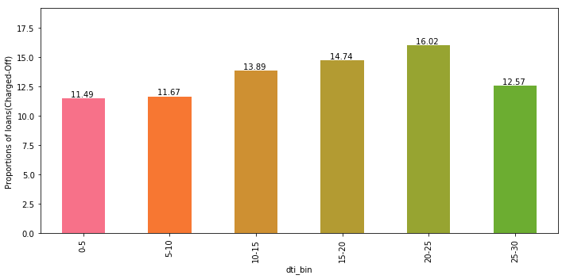
Analysis – Defaults by Debt to Income Ratio
Higher interest rates should be charged for higher dti, but we see spread across all values.
Percentage of default rises with dti ratio
As the dti ratio rises above 20, the loans become risky

Slide 18
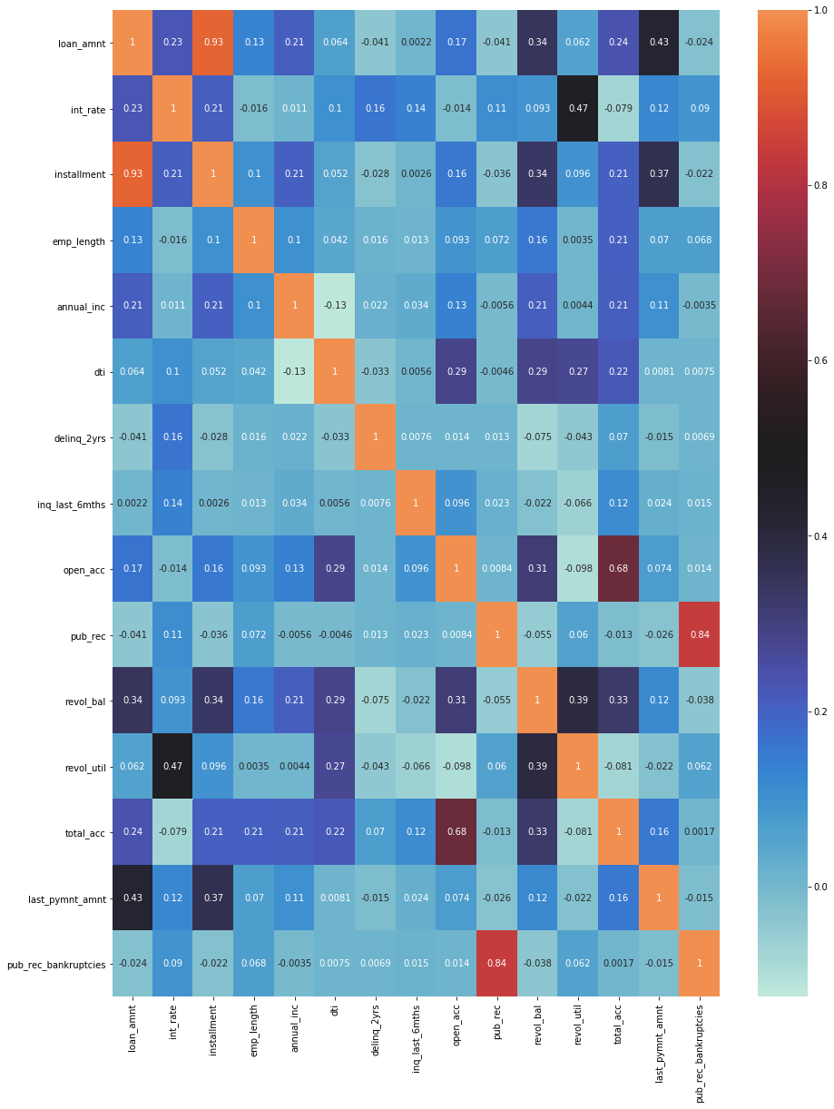
Correlation
1)loan_amnt is correlated to last_payment_amount with coefficient 0.44.
2)int_rate is correlated to revol_util with 0.47.
3)delinq_2yrs is totally un-correlated with public record of bankruptcy. Therefore they represent distinct features with individual predictive value.

Slide 19
Conclusion
Detailed analysis from the heatmap shows that variables grade, sub_grade, home_owership, revol_util and dti are some of the strong indicators of loan default of borrowers. Applicants living in rented or mortgaged home with high revolving amount utilization, high debt to income ratio and low LC grade (> G2) holds high risk of defaulting the loan. Hence these variables can be used while scrutinizing new loan applications to filter out possible defaulters.

